Slide 1


Slide 2
The Aim of the Synod:
The Synodal Conversion of the Church
Renewing our structures and processes so that
all can participate in a trinitarian communion that lives out
a shared commitment to Jesus’ mission
Focus for Second Session:
How to be a synodal Church on mission?

Slide 3
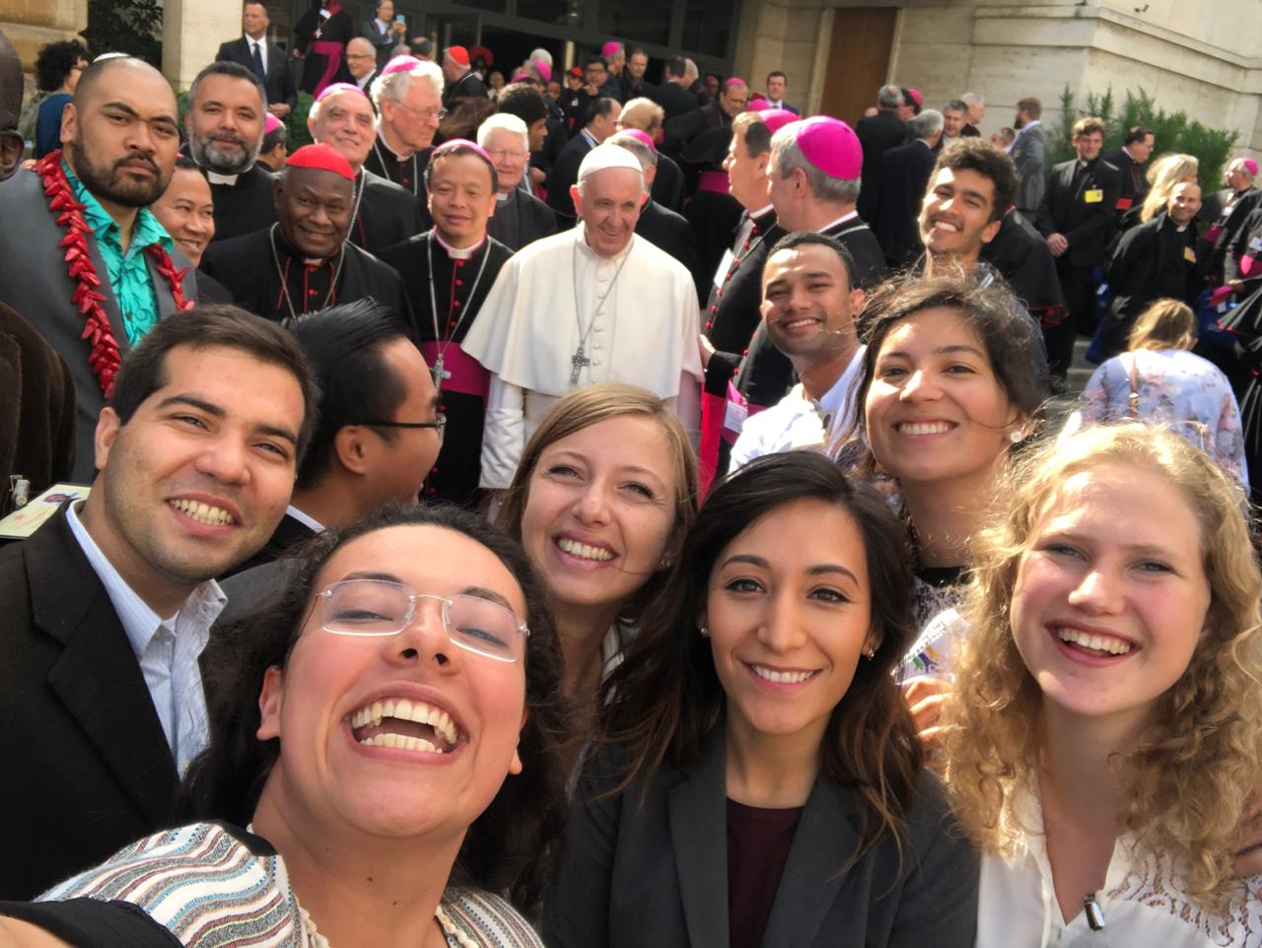
“Synodality is the way of being the Church today according to the will of God, in a dynamic of discerning and listening together to the voice of the Holy Spirit.”
Pope Francis

Slide 4
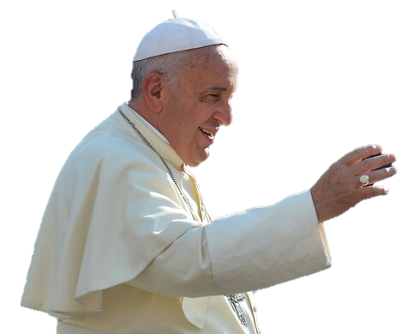
Pope Francis on Synodality
To hold a “synod” means to walk together.
I think this is truly the most wonderful experience we can have: to belong to a people walking, journeying through history together with their Lord who walks among us!
We are not alone; we do not walk alone.
We are part of the one flock of Christ that walks together.
(Feast of St Francis of Assisi, 4 October 2013)
It is not enough to have a synod; you must be a synod.
The Church needs intense internal sharing:
a living dialogue between the Pastors and between the Pastors and the faithful.
(Synod of the Ukrainian Greek-Catholic Church, 5 July 2019)

Slide 5

A Synodal Church on Mission
Synod (‘walking together’) describes structures that embody the ecclesiology of Vatican II
“Lumen Gentium sets out a vision of the nature and mission of the Church as communion … her nature as People of God on pilgrimage through history towards the heavenly homeland, in which all her members are by virtue of baptism honoured with the same dignity as children of God and appointed to the same mission.”
(ITC, Synodality, n. 40)
“In the gift and commitment of [trinitarian] communion can be found the source, the form and the scope of synodality, inasmuch as it expresses the specific modus vivendi et operandi of the [pilgrim] People of God in the responsible and ordered participation of all its members in discerning and putting into practice ways of fulfilling its mission.”
(ITC, Synodality, n. 43)

Slide 6
Overview
Vatican II Ecclesiology:
People of God
Synodality: Discernment and Dialogue
Current Synod
Local experiences:
Plenary Council & Dioceses
‘Enlarge the Space of Your Tent’

Slide 7
Vatican II, Lumen Gentium
De Ecclesia (rejected schema, 1962)
The Nature of the Church Militant
The Members of the Church Militant and her Necessity for Salvation
The Episcopate
Residential Bishops
Evangelical Perfections
The Laity
The Teaching Office of the Church
Authority and Obedience
in the Church
Relations between Church and State
The Church’s Obligation to Proclaim the Gospel to all Nations of the World
Ecumenism
Lumen Gentium (1964)
The Mystery of the Church
The People of God
The Hierarchical Structure
of the Church
The Laity
The Universal Call to Holiness
Religious
The Eschatological Nature
of the Pilgrim Church
The Blessed Virgin Mary,
Mother of God,
in the Mystery of Christ
and the Church

Slide 8
Lumen Gentium
Chapter 1 – The Mystery of the Church
‘Christ is the Light of nations’
→ mission of the Church: ‘to bring the light of Christ to all people’ (n. 1)
‘The Church is in Christ like a sacrament or as
a sign and instrument both of a very closely knit union with God
and of the unity of the whole human race’ (n. 1)
Mission: ‘to proclaim and to spread among all peoples
the Kingdom of Christ and of God and to be, on earth,
the initial budding forth of that kingdom’ (n. 5)
Baptism → Body of Christ (n. 7)
Church of Christ ↔ Catholic Church (n. 8)

Slide 9
Lumen Gentium, Chapter 2 – The People of God
‘The baptized, by regeneration and the anointing of the Holy Spirit, are consecrated as a spiritual house and a holy priesthood’ (n. 10)
Sensus fidei fidelium: ‘The holy people of God shares also in Christ’s prophetic office … The entire body of the faithful … cannot err in matters of belief … That discernment in matters of faith is aroused and sustained by the Spirit of truth.’ (n. 12a) → convergence, consensus
Variety of gifts: ‘the Holy Spirit … distributes special graces among the faithful of every rank … [to] contribute toward the renewal and building up of the Church.’ (n. 12b) → diversity, tension
Universal communion serving all humanity
‘God sent His Son … that he might be teacher, king and priest of all, the head of the new and universal people’ (n. 13)
Relation to other Christians (n. 15), Jewish people, other faiths,
those without belief (n. 16)

Slide 10
Pope Francis on the Synod
The Synod is neither a convention, nor a ‘parlour’, a parliament nor senate, where people make deals and reach a consensus. The Synod is rather an ecclesial expression, i.e., the Church that journeys together to understand reality with the eyes of faith and with the heart of God … The Synod is not a parliament in which to reach a consensus or a common accord by taking recourse to negotiation, to deal-making, or to compromise: indeed, the only method of the Synod is to open oneself up to the Holy Spirit
with apostolic courage,
with evangelical humility
and confident, trusting prayer,
in order that he guide us, enlighten us and make us keep before our eyes,
not our personal opinions, but with faith in God, fidelity to the Magisterium,
the good of the Church and the salus animarum.
(Opening of Synod for the Family, 29 October 2015)

Slide 11
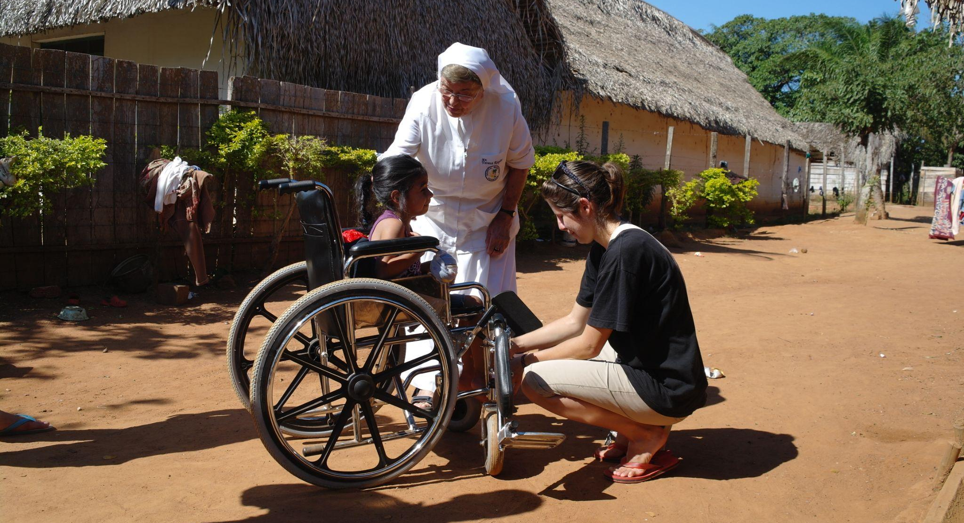
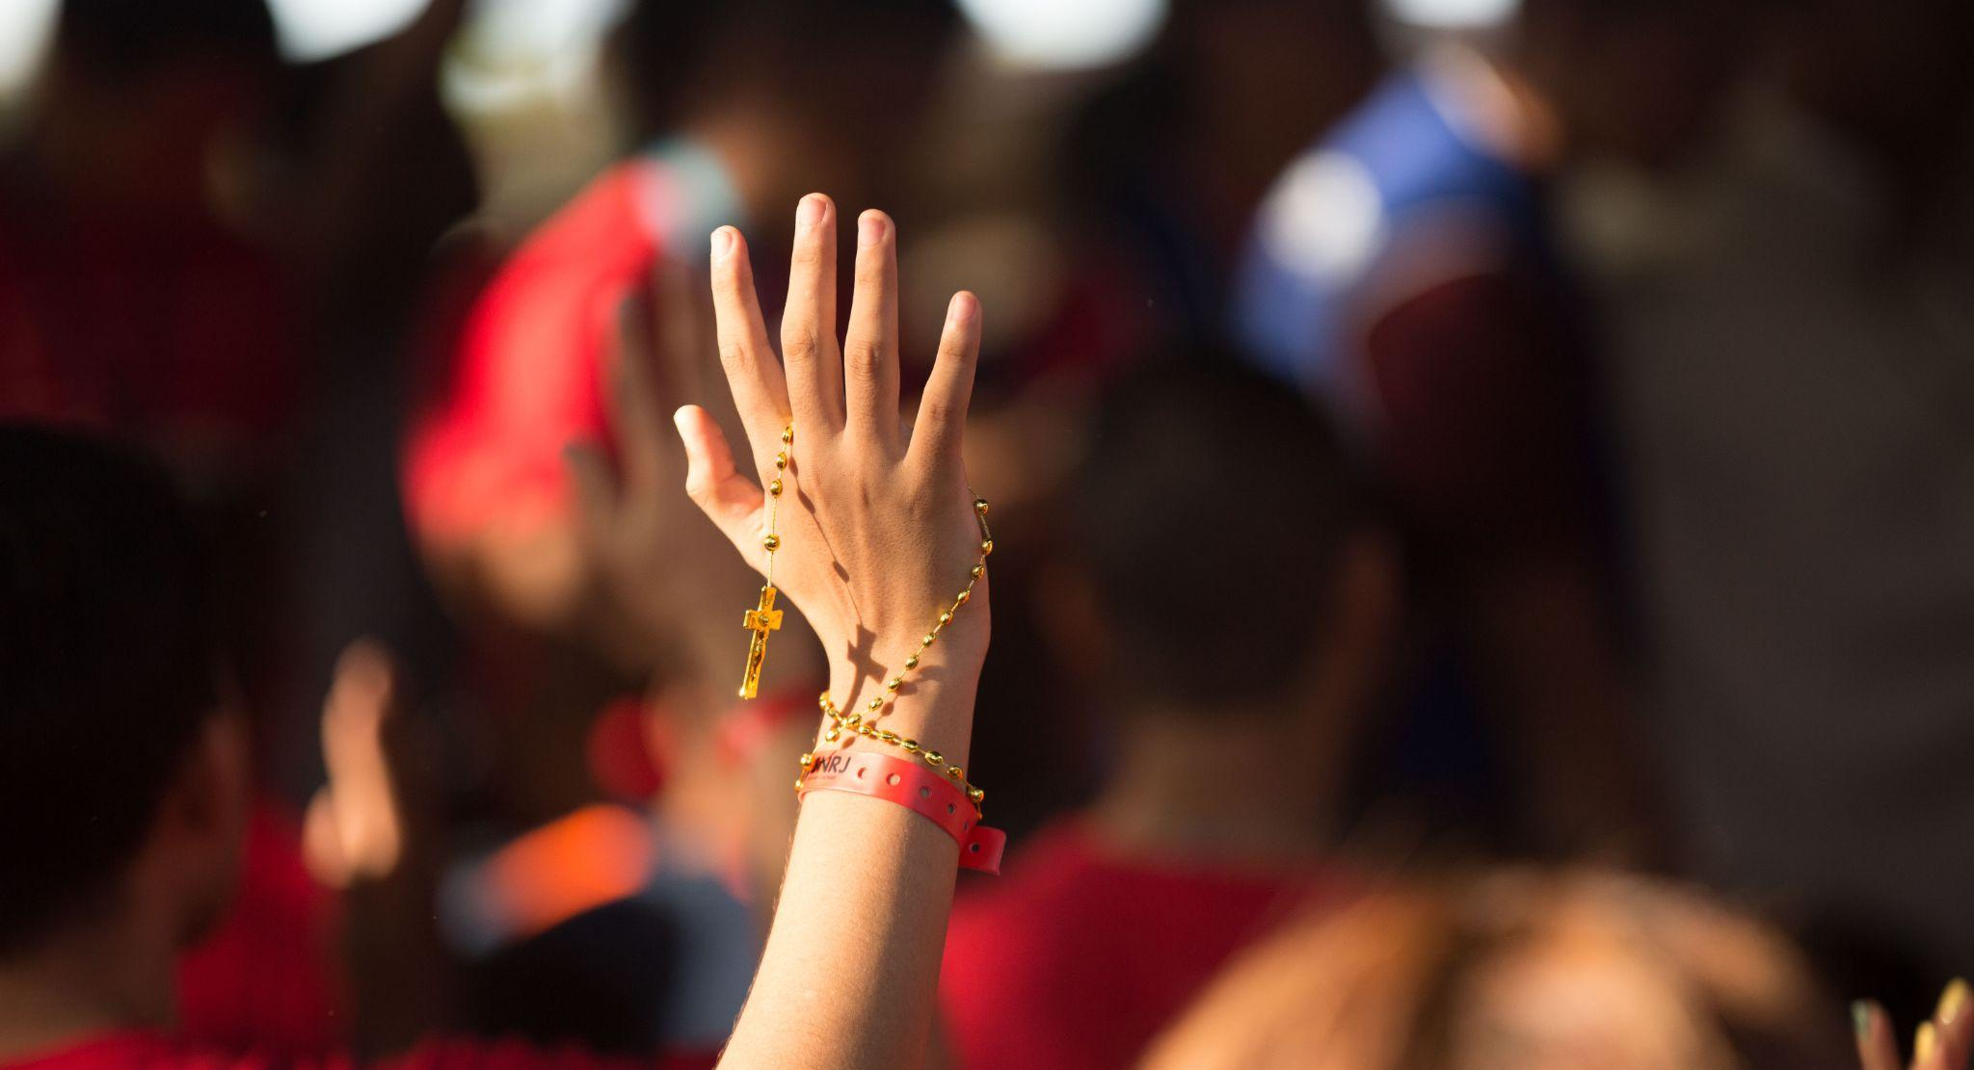
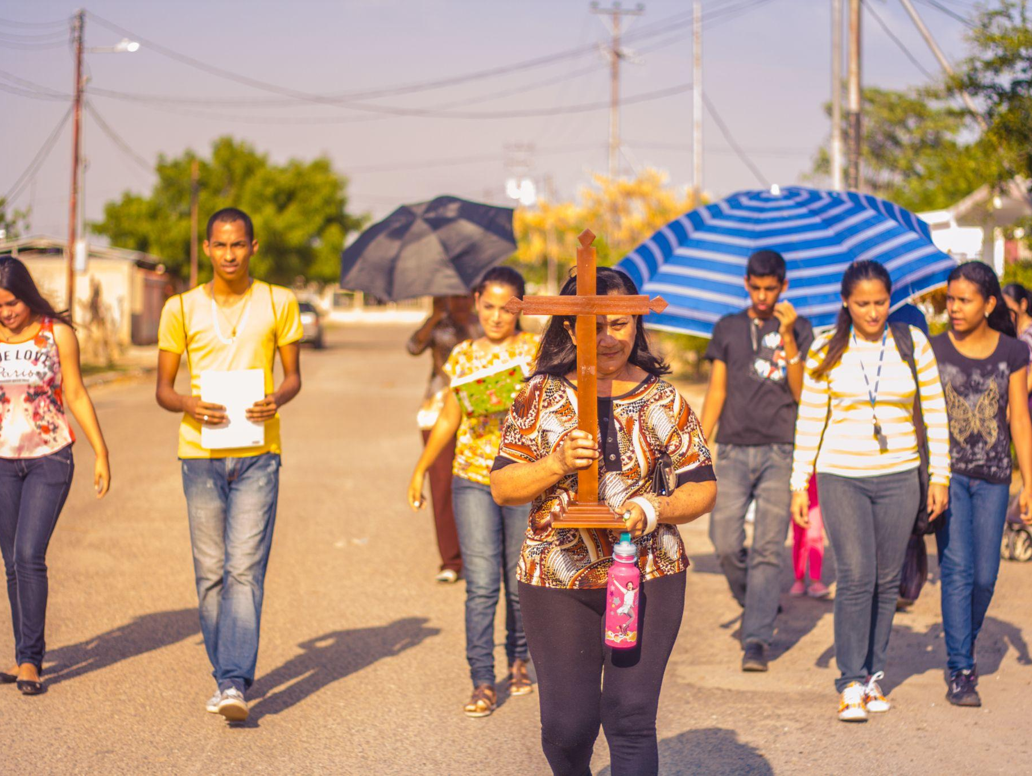
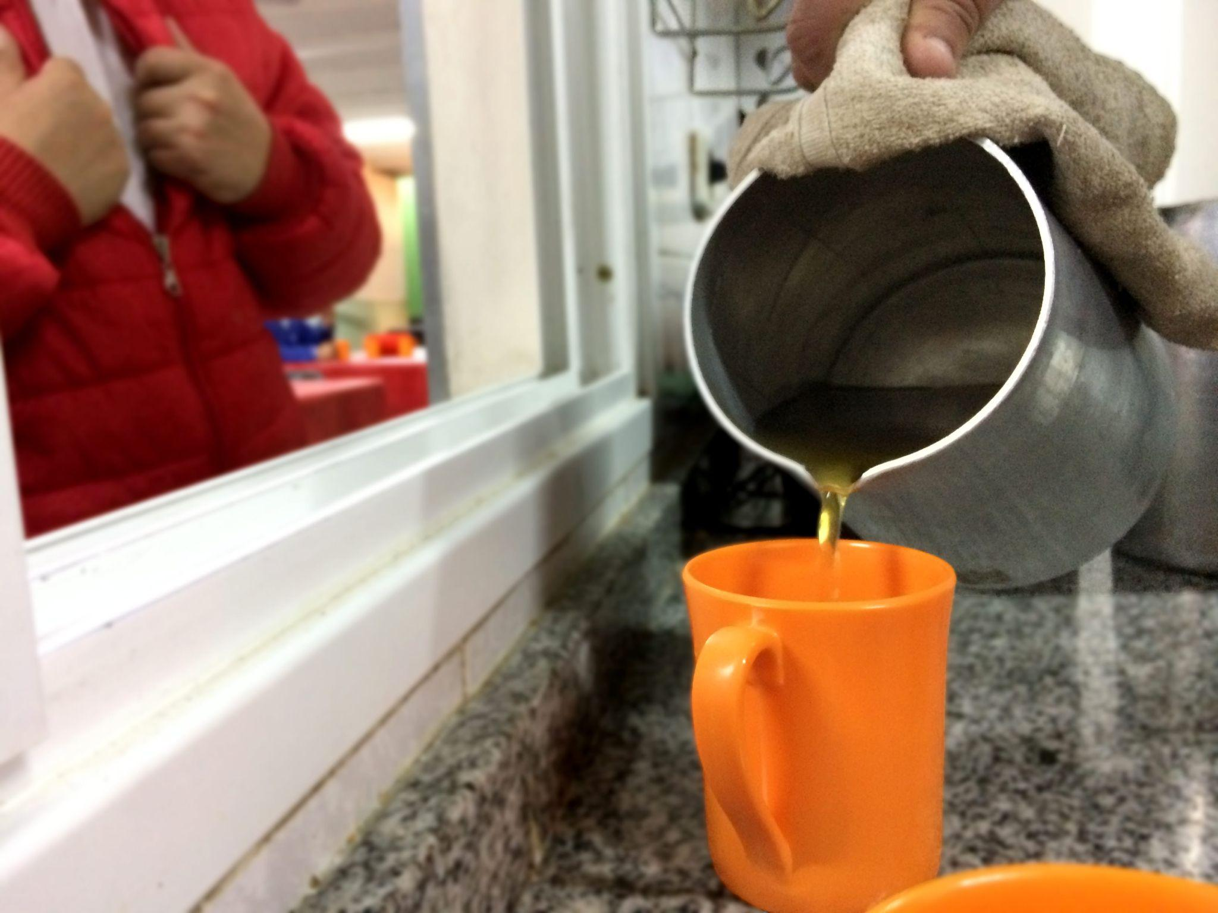
Key convictions for a Synodal Church
Listen to one another
in order to listen to the Holy Spirit
In a spirit of prayer,
grounded in liturgy and the Word of God
A way of being Church, not a one-time event
An experience shared with one another (communion)
Discerning together so that decisions are made for the good of all (participation)
To renew our prophetic witness
to the human family (mission)

Slide 12
Discernment
‘Discernment is the grace given to the holy faithful people of God by the Spirit, who constitutes it a prophetic people …
‘Therefore, I invite you to cultivate an attitude of listening, growing in the freedom of relinquishing one’s own point of view …
to assume that of God …
‘Discerning therefore means humility and obedience.
Humility with regard to one’s own projects. Obedience to the gospel … to the magisterium … and to the concrete situation of the people.’
Pope Francis, Address to new Bishops, 2017
‘Never make a change without a process of discernment … And this will give you freedom, for you place the Holy Spirit there in the midst of the change.’ Pope Francis, Address to Superiors General, 2016

Slide 13
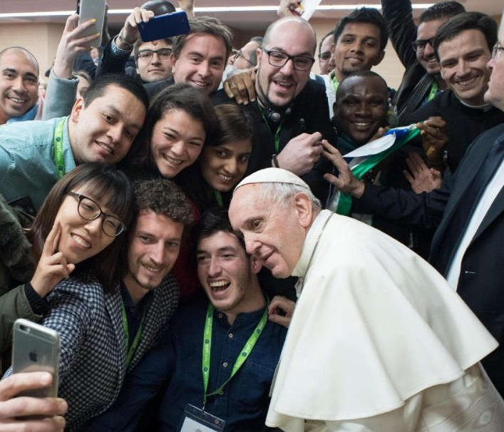
Truth-telling and Dialogue: Speak boldly, Listen humbly
I wish, therefore, at the beginning of the Synod Assembly, to invite everyone to speak with courage and frankness … Only dialogue can help us grow. An honest, transparent critique is constructive and helpful … And humility in listening must correspond to courage in speaking. I told the young people in the pre-Synod Meeting: ‘If you say something I do not like, I have to listen even more, because everyone has the right to be heard, just as everyone has the right to speak’. This open listening requires courage in speaking … It is this listening that creates space for dialogue … To speak frankly and listen openly are fundamental if the Synod is to be a process of discernment. Discernment is … an interior attitude rooted in an act of faith. Discernment is the method and at the same time the goal we set ourselves: it is based on the conviction that God is at work in world history, in life’s events, in the people I meet and who speak to me.
Pope Francis, Opening of the Synod on Young People, 3 October 2018

Slide 14

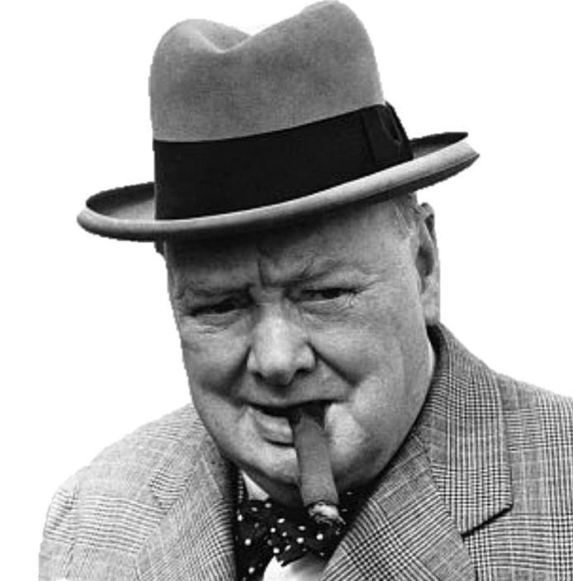
Courage and Humility
Give us the courage to tell our stories
and to speak boldly of your truth.
Give us ears to listen humbly to each other
and a discerning heart to hear what you are saying.
Plenary Council prayer
Courage is what it takes to stand up and speak;
courage is also what it takes to sit down and listen

Slide 15
Pope Francis on Dialogue
‘Dialogue … is a sign of great respect, because it puts the person into a stance of listening, and into a condition of being receptive to the speaker’s best viewpoints.
‘Many times, we do not encounter our brothers and sisters … especially when we give precedence to our position over that of the other … We do not dialogue when we do not listen well enough, or when we tend to interrupt the other person in order to show that we are right … How many times as we are listening to a person, do we stop them and say: “No! No! It isn’t so!” and we do not allow the person to finish explaining what they want to say … True dialogue, instead, requires moments of silence in which to understand the extraordinary gift of God’s presence in a brother or sister.’ Jubilee Audience, 22 October 2016.
‘Carrying on a dialogue means being convinced that others have something good to say; it means making room for their viewpoint, their opinion, their suggestions.’
Address to La Civiltà Cattolica, 14 June 2013.
‘Dialogue presupposes and demands that we seek a culture of encounter, an encounter that acknowledges that diversity is not only good, it is necessary. Uniformity nullifies us; it makes us robots. The richness of life is in diversity … I dialogue with my identity but I’m going to listen to … how I can be enriched by the other.’
Meeting with representatives of civil society, 11 July 2015

Slide 16
Fratelli Tutti (2020) on Dialogue and Encounter
Dialogue ≠ ‘feverish exchange of opinions on social networks
… [that] are merely parallel monologues’ (n. 200)
Political point-scoring has become model for all conversation
Many valid approaches to reality (n. 204) needs to be held alongside
‘search for the solid foundations sustaining our decisions and our laws’ (n. 208)
  Justice, affirming ‘each human being is sacred and inviolable’ (n. 207)
  vs. ‘superficial bartered consensus’ (n. 210)
Dialogue can lead to shared insight into truth (nn. 211–12)
Dialogue recognises ‘differences coexist, complementing, enriching and reciprocally illuminating one another … Each of us can learn something from others … includ[ing] those on the peripheries’ (n. 215)
‘Processes of encounter … build a people that can accept differences’ (n. 218)
‘No one can possess the whole truth … dialogic realism … [that] remains faithful to their own principles while recognising that others also have the right to do likewise’ (n. 221)
  ‘We have to stand in the place of others, if we are to discover what is genuine, or at least understandable, in their motivations and concerns’ (n. 221)

Slide 17
Circularity of Dialogue
“The circularity of the sensus fidei with which all the faithful are endowed, the discernment carried out at the various levels on which synodality works and the authority of those who exercise the pastoral ministry of unity and governance shows the dynamic of synodality. This circularity promotes the baptismal dignity and coresponsibility of all, makes the most of the presence in the People of God of charisms dispensed by the Holy Spirit, recognises the specific ministry of Pastors in collegial and hierarchical communion with the Bishop of Rome, and guarantees that synodal processes and events unfold in conformity with the depositum fidei and involve listening to the Holy Spirit, for the renewal of the Church’s mission.”
(ITC, Synodality, n. 72)
“The implementation in the local Church and on every level of the circular relationship between the ministry of Pastors, the participation and co-responsibility of lay people, the stimulus coming from the charismatic gifts according to the dynamic circular link between ‘one’, ‘some’ and all’.” (ITC, Synodality, n. 106a)

Slide 18
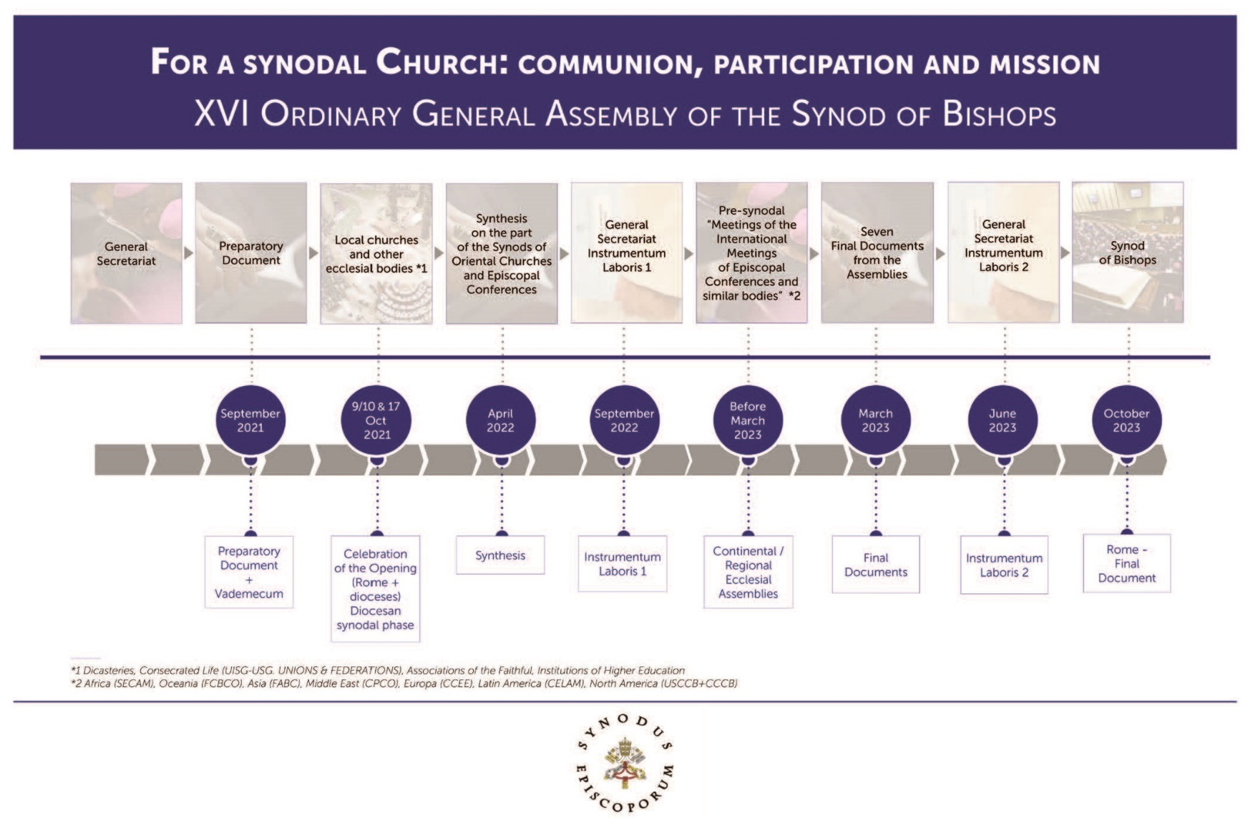

May 2021
7

Slide 19
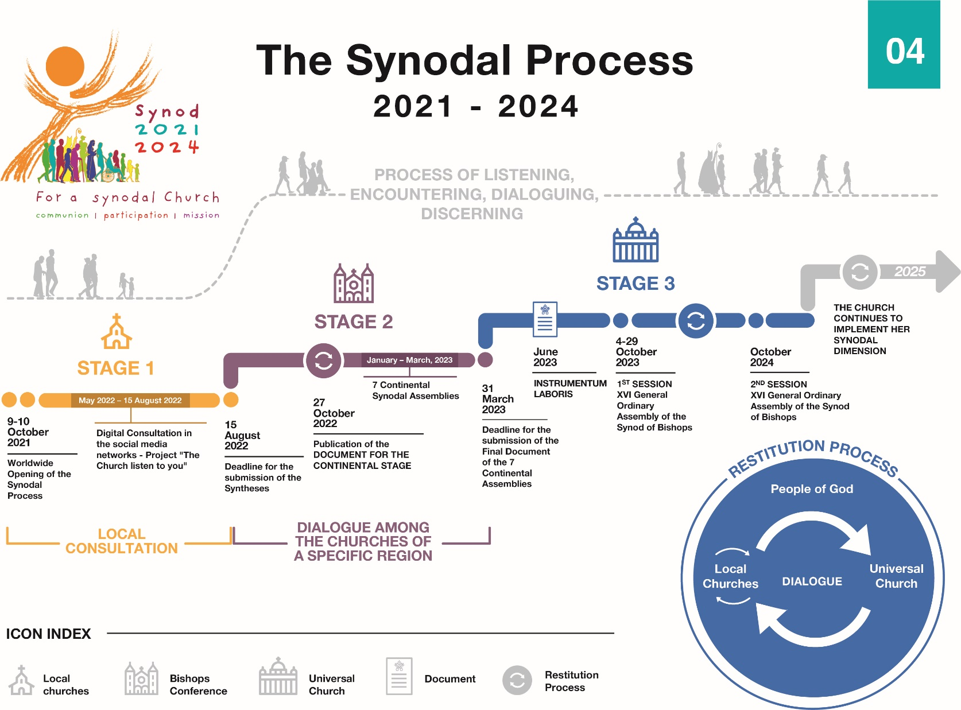
October 2022

Slide 20
Participation on the basis of baptism
363 voting members (including 54 women)
  189 bishops nominated by Bishops Conferences
  15 bishops from Synod Council (elected at last synod)
  77 from continents (1 bishop + 10 others from each continent)
  23 from Roman curia (including 1 religious sister, 1 lay man)
  61 nominated by Pope Francis
    38 bishops
    13 priests
    6 religious sisters
    5 lay people (2 men, 3 women)
  10 superiors general (5 men, 5 women)
12 fraternal delegates from other Christian denominations
62 facilitators and theologians
43 assistants

Slide 21
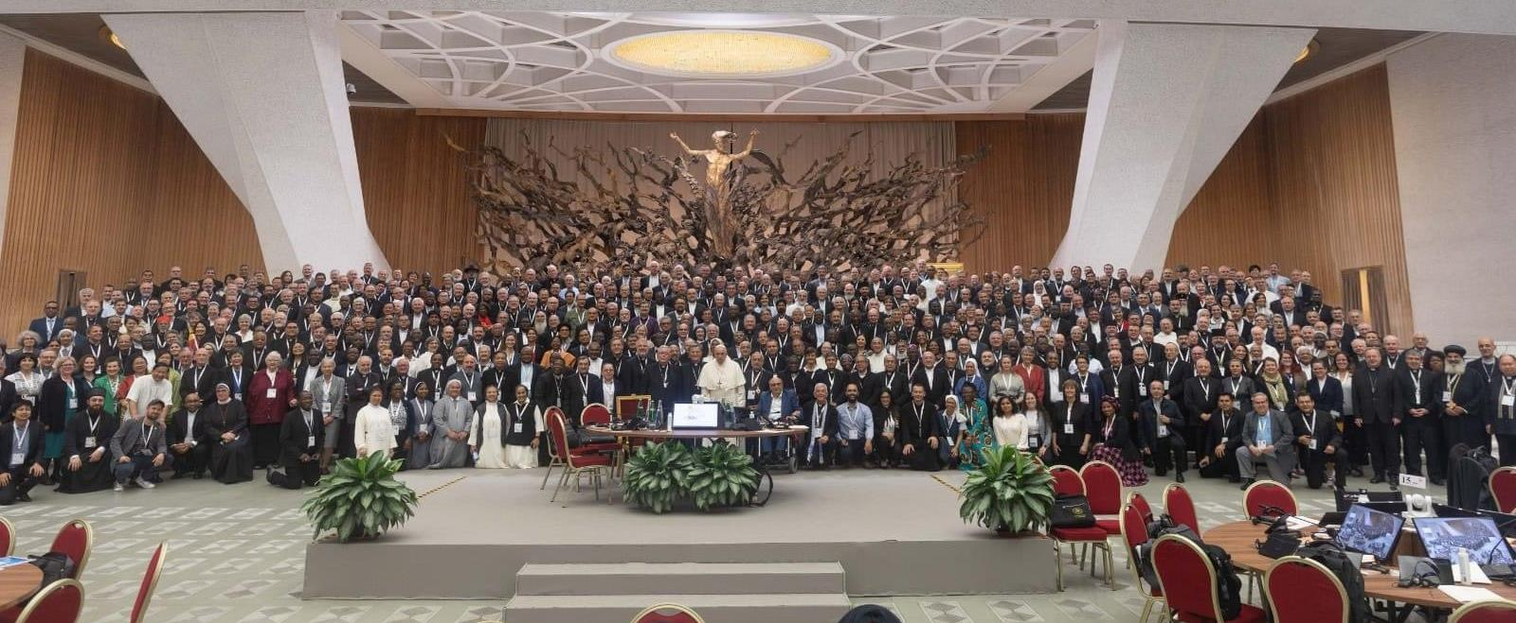

Slide 22
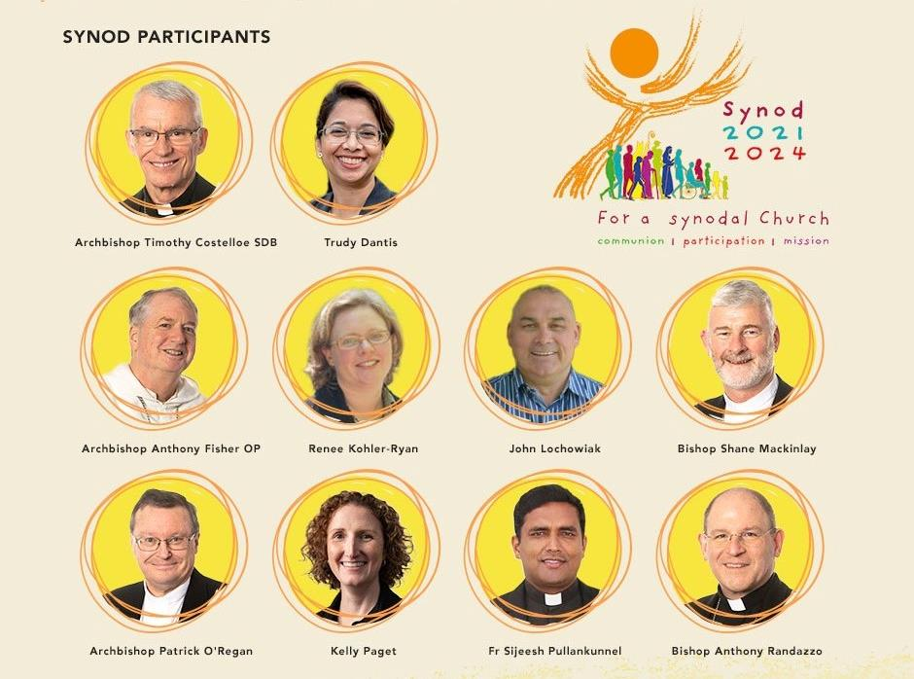
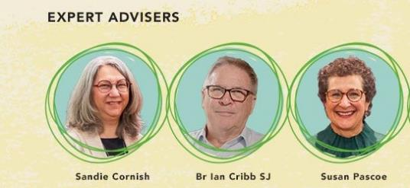
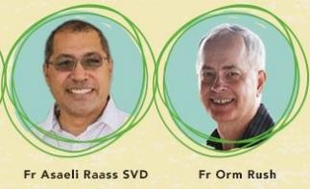
Australian Participation in the Synod Assembly
MEMBERS
EXPERTS & FACILITATORS

Slide 23
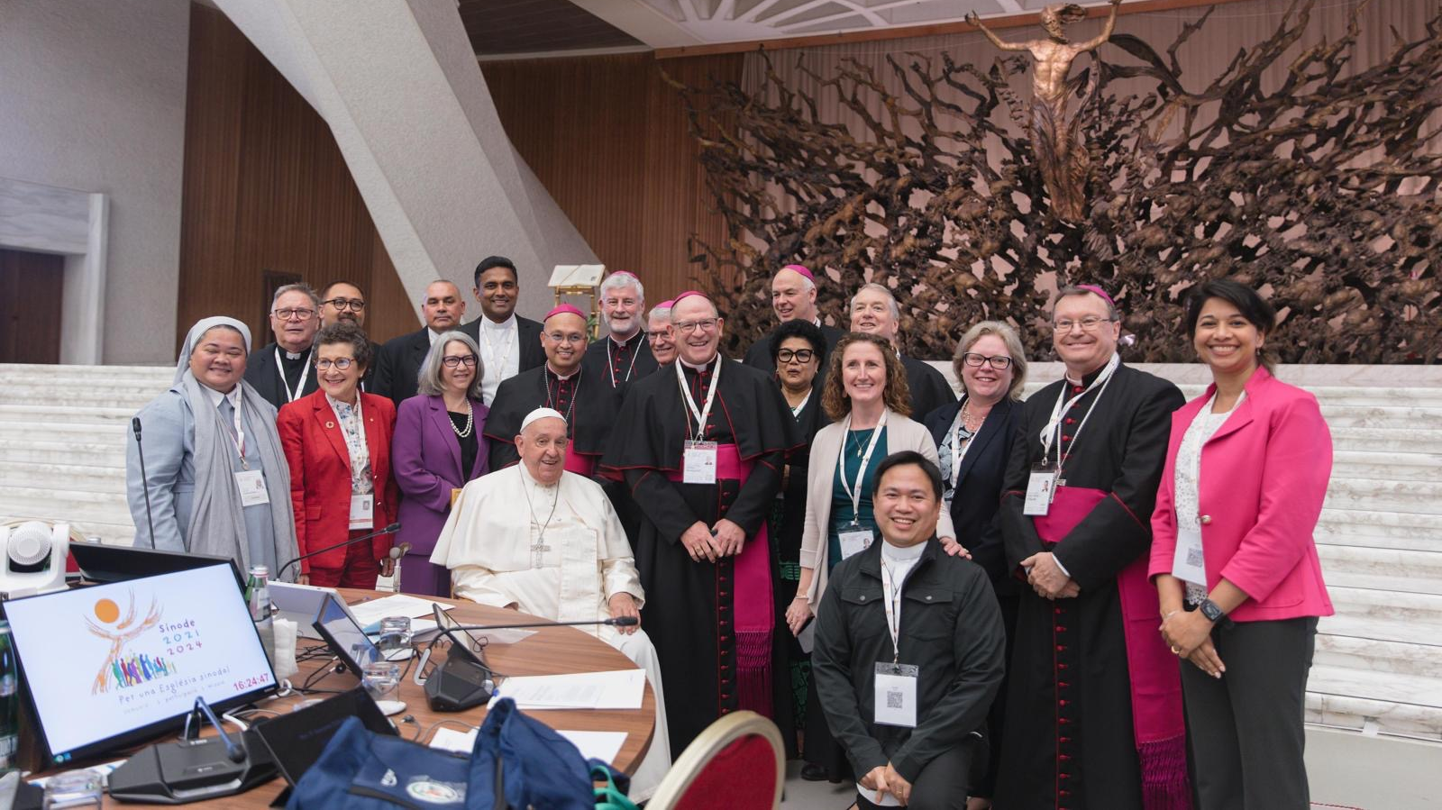

Slide 24
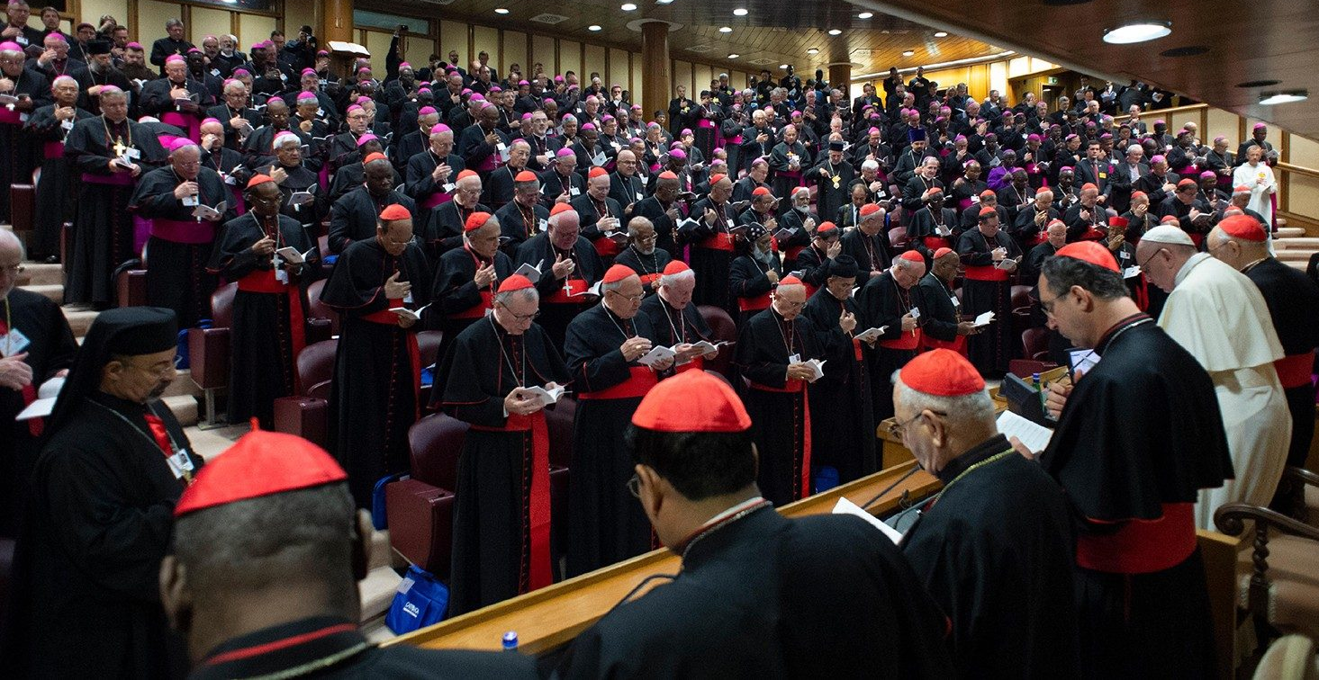
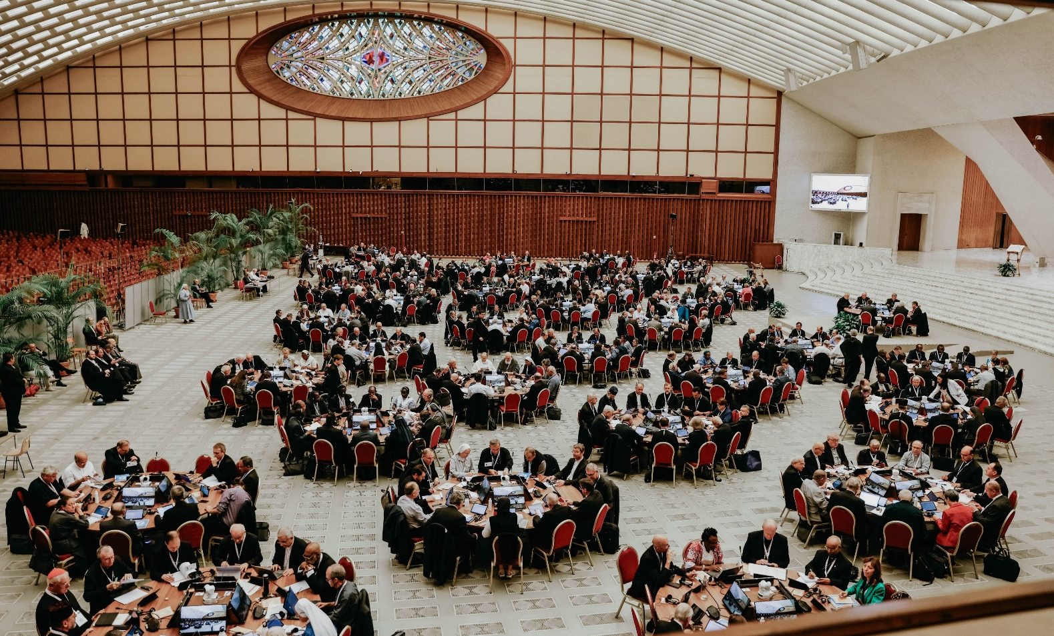

Slide 25
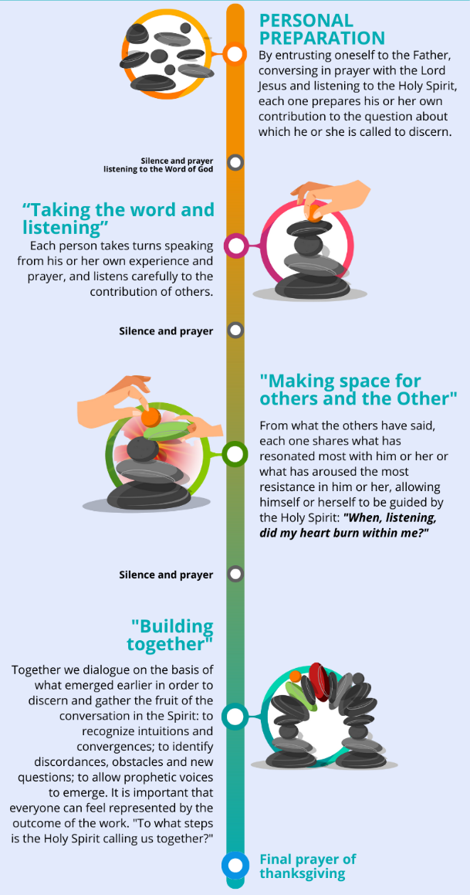

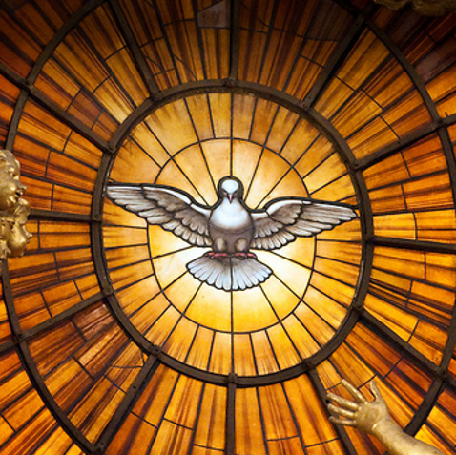

Discernment:
Listening to one another and to the Holy Spirit
Conversation in the Spirit
I
→ We
→ Holy Spirit

Slide 27
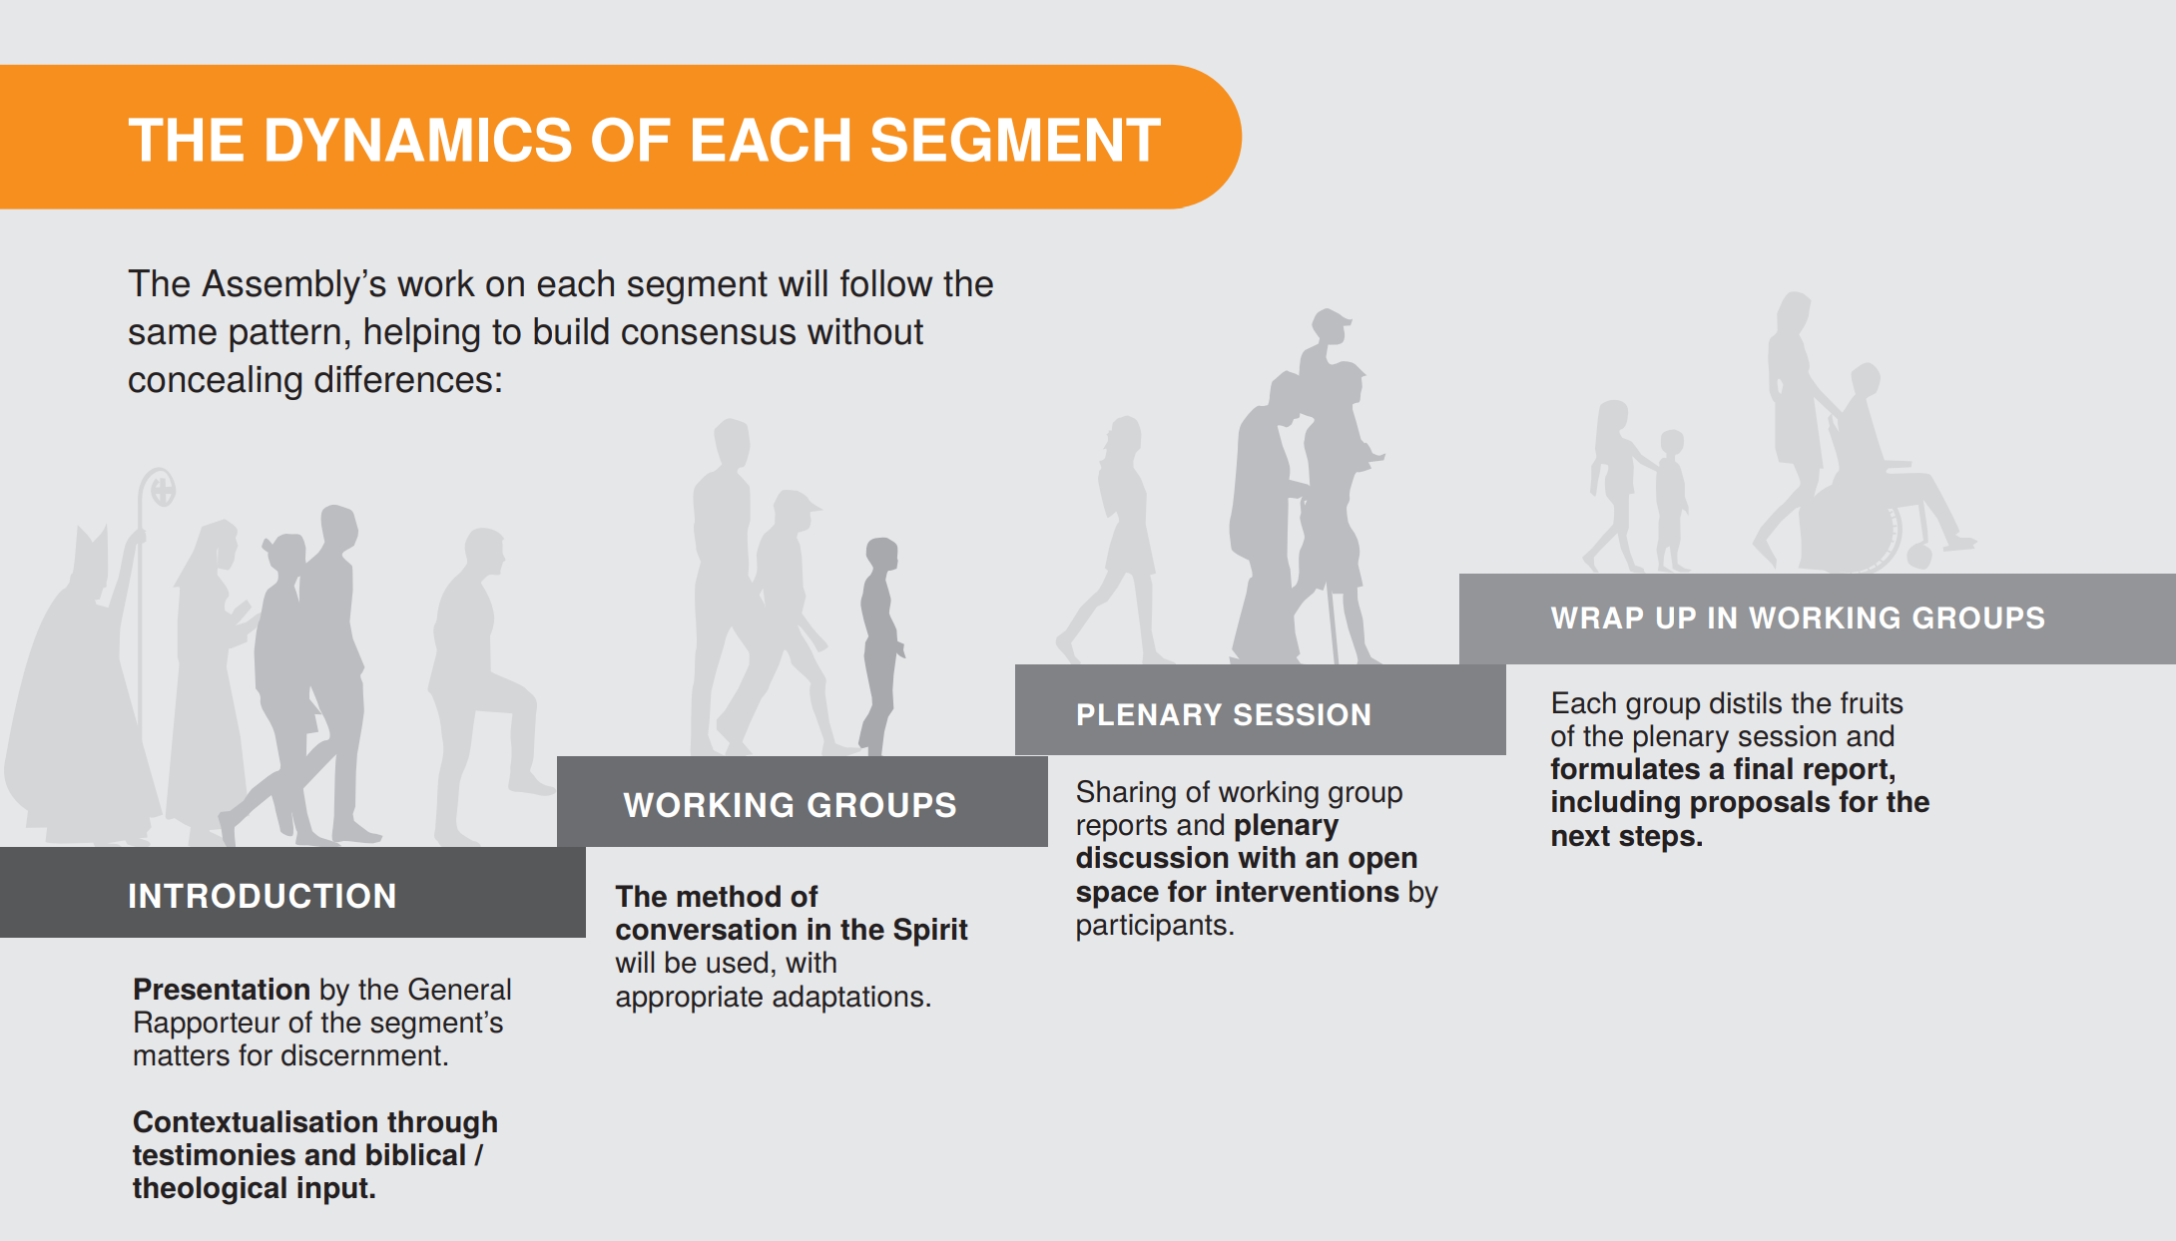

Slide 28
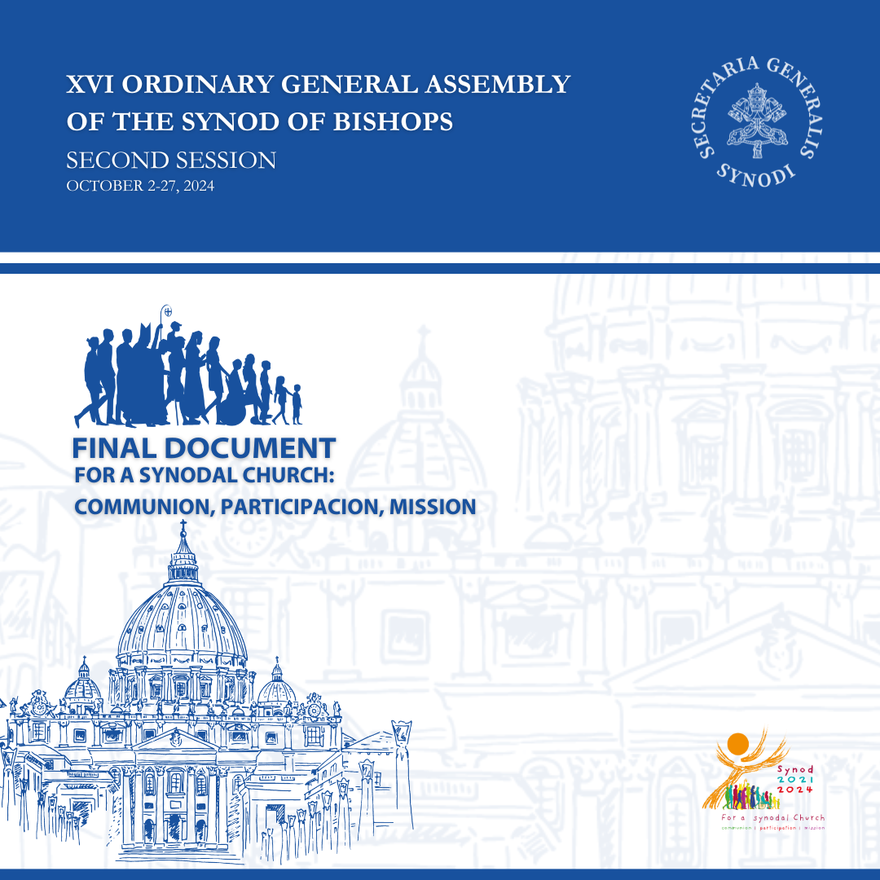
Acknowledging the value of the synodal journey undertaken, I now hand over to the whole Church all that is contained in the Final Document restoring to the Church what has matured over these years through listening and discernment and as an authoritative orientation for the Church’s life and mission.
The Final Document is part of the ordinary Magisterium of the Successor of Peter … and as such, I ask that it be welcomed and received.
Pope Francis

Slide 29
Implementation
The conclusion of the XVI Ordinary General Assembly of the Synod of Bishops does not put an end to the synodal process …
In many cases, it is a matter of effectively implementing what is already provided for in existing law … In other cases, it will be possible to proceed, through a synodal discernment and within the framework of the possibilities outlined in the Final Document, to the creative activation of new forms of ministeriality and missionary action, experimenting and testing or verifying these experiences. In the report envisaged for the ad limina visit, each bishop will take care to report what choices have been made in the local Church entrusted to him in relation to the indications in the Final Document …
Pope Francis

Slide 30
The Church as the People of God (Vatican II)
Baptism is the foundation of the Christian life and ministry
Synodality
Mutual listening
Dialogue
Communal discernment
Consensus
Differentiated co-responsibility of all the baptised
Participation
Need to rebuild trust
Synodality as a critical and prophetic voice

Slide 31
Many feel excluded or judged
Equal dignity and reciprocity between men and women
“The widely expressed pain and suffering on the part of many women from every region and continent … reveals how often we fail to do so”
Women should be in leadership roles
Attention to language and images in preaching, liturgy, documents
Critical role of consultation in decision-making
Transparency and accountability
Pastoral Councils mandatory and to operate synodally
Parishes need to recognise changing shape of local community

Slide 32
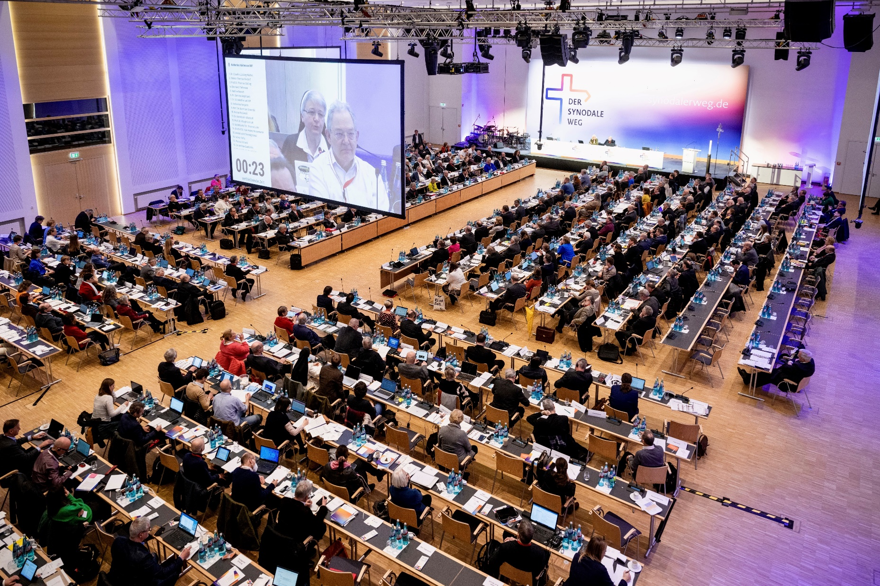
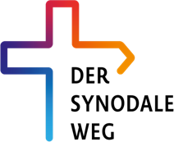

Slide 33
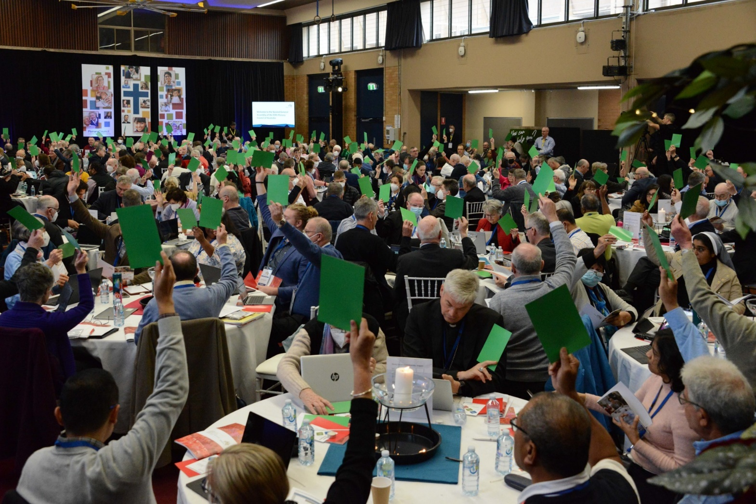

Synodality in Australia

Slide 34
Fifth Plenary Council of Australia, 2018–2022
2018–2019: Listening and Dialogue:
‘What do you think God is asking of us in Australia at this time?’
  222,000 people
  17,500 submissions
2019–2020: Six National Themes for Discernment
January 2021: Instrumentum Laboris
October 2021: First Assembly (277 members; 18 periti; 20–30 staff)
  Final Statement
  ‘Fruits’
December 2021: Four Thematic focuses and writing groups
April 2022: Proposals Framework (eight parts)
May 2022: Framework for Motions
July 2022: Second Assembly (eight decrees)

Slide 35
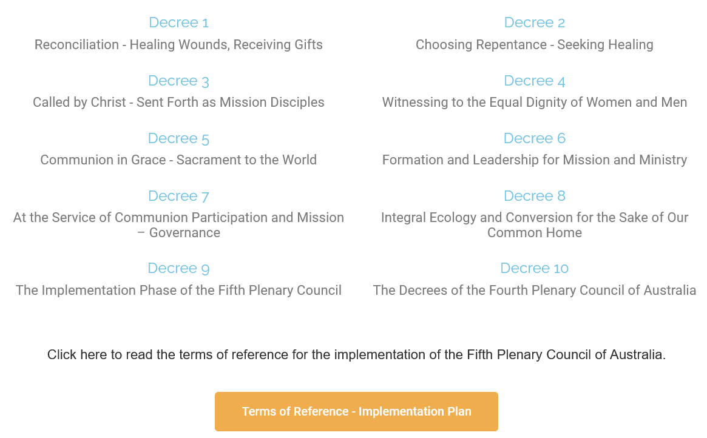
Plenary Council Decrees

Slide 36
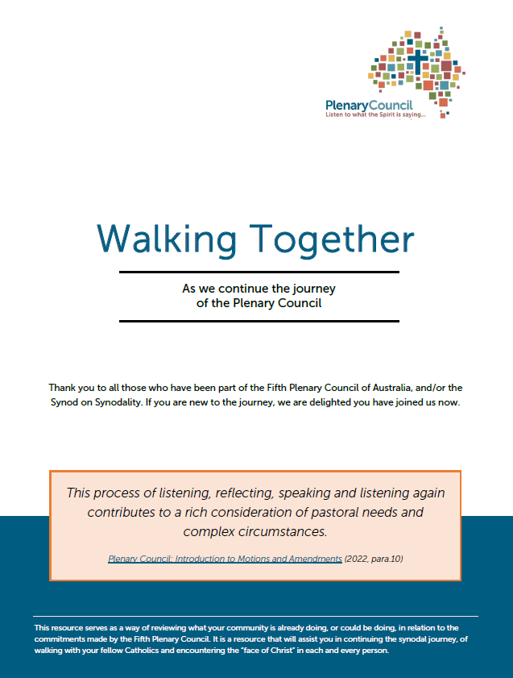

Slide 37
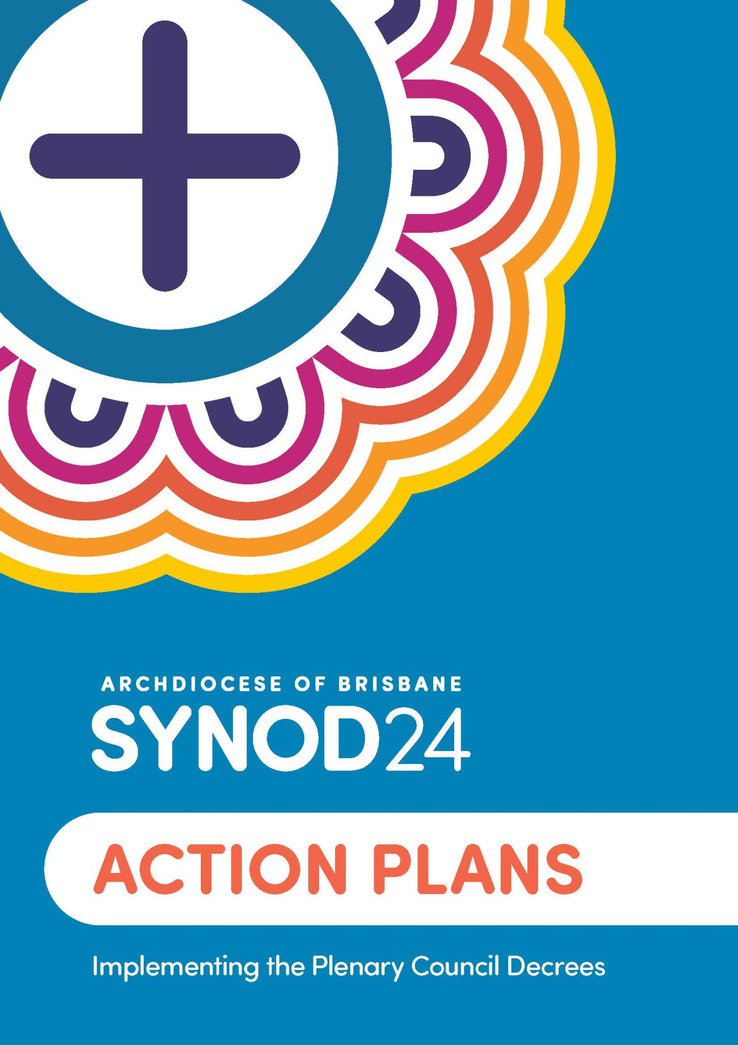

Slide 38
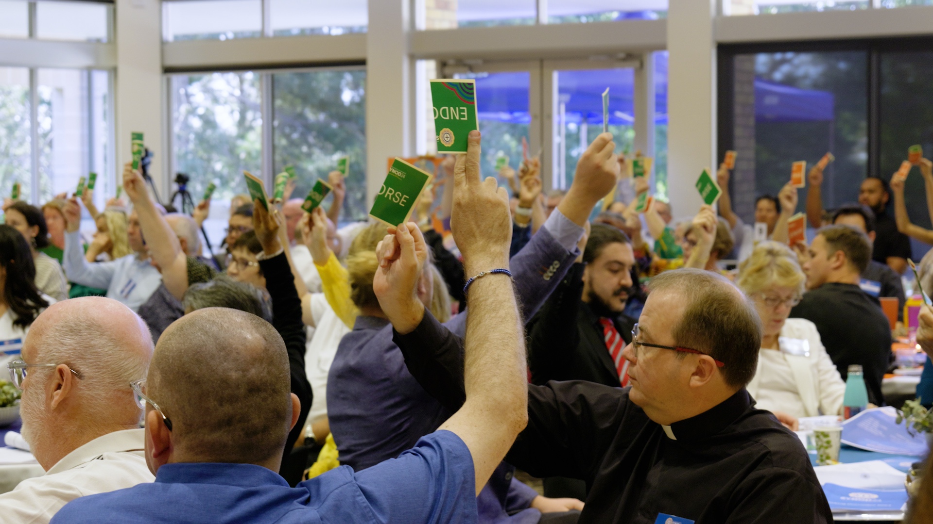

Slide 39
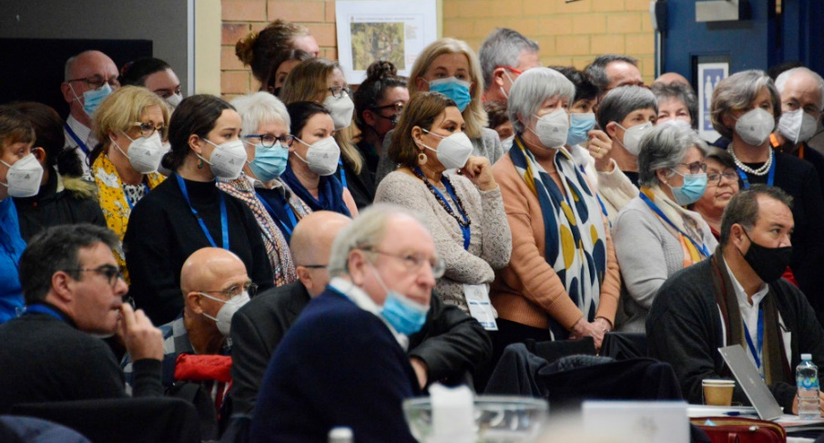
Dialogue at the Plenary Council
Shared commitment to ensure positive outcome
  The failed vote could not be the last word
Courageous speaking
  Not just about boldness
  All affected viscerally
    had spoken from head (exchange of ideas)
    needed to speak from heart
    (putting myself on the line; lived experience of how I am affected)
Humble listening
  listen in a way that is open to conversion
  listening from heart rather than with intellectual response or counter-argument
  open to learning = letting go = costly listening
  content of text didn’t change much, but people felt heard,
  and appreciated/valued other views differently

Slide 40
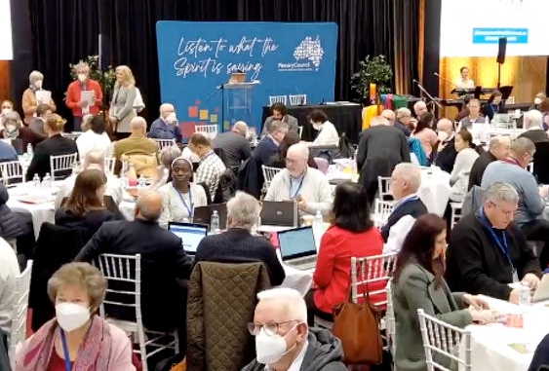
Learnings about Dialogue from the Plenary Council
Process of learning (rather than convincing!)
Conversion: openness to the Holy Spirit
Don’t conclude decision-making and discerning
until it is clear that there is consensus about a way forward
Voting?
  Adversarial
  Division rather than decision
  Winner takes all
  Minority/periphery marginalised
  Discernment is not popular opinion
  Avoid voting as much as possible
Structure to articulate and formalise
decision-taking

Slide 41
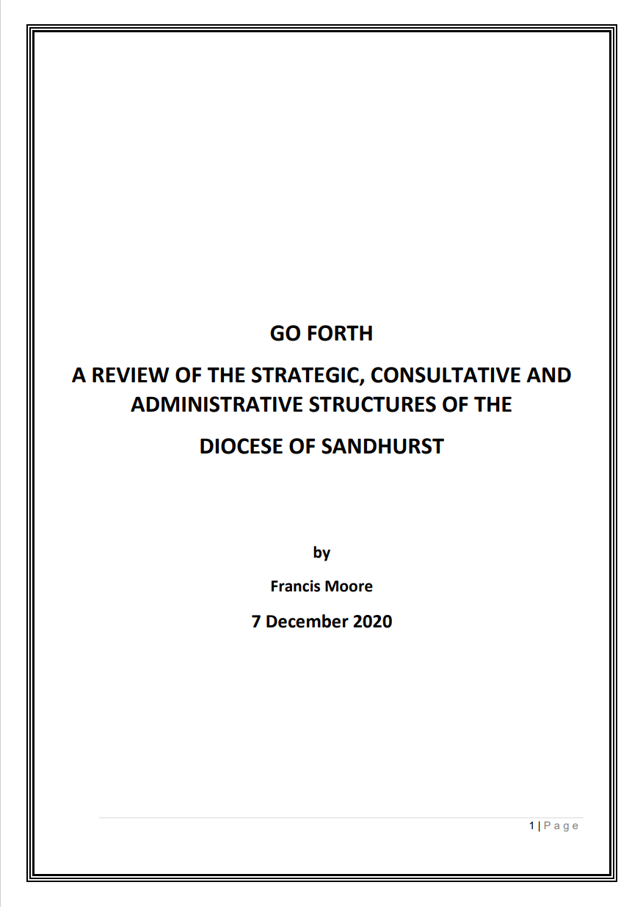
Synodality in Sandhurst

Slide 42
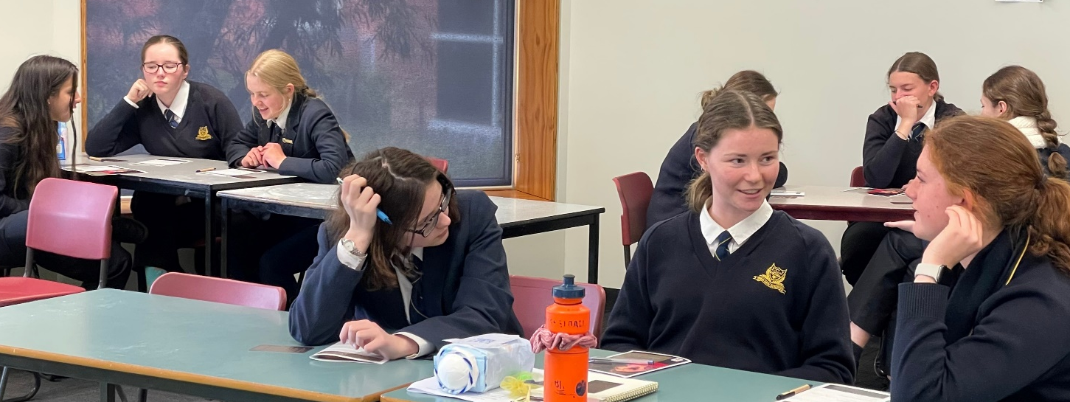
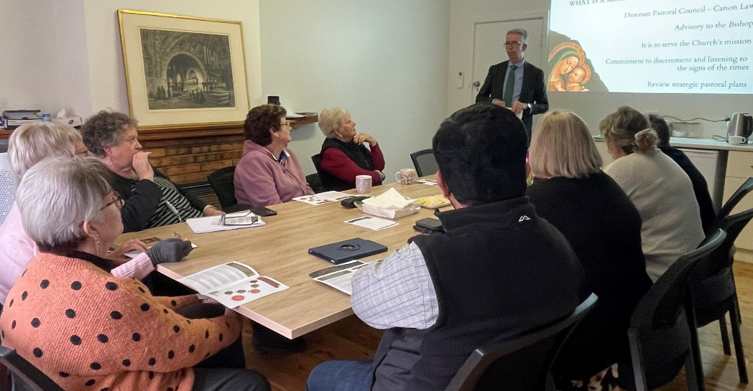
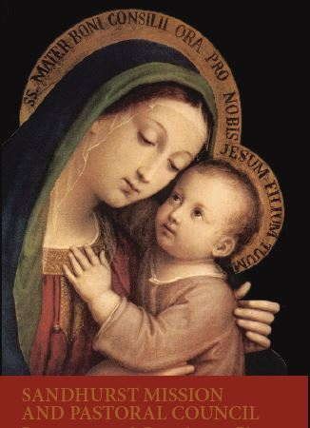
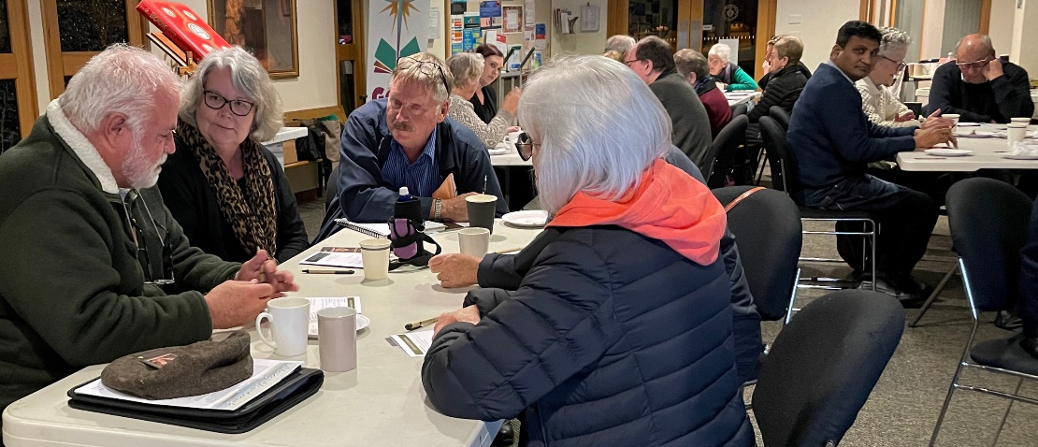
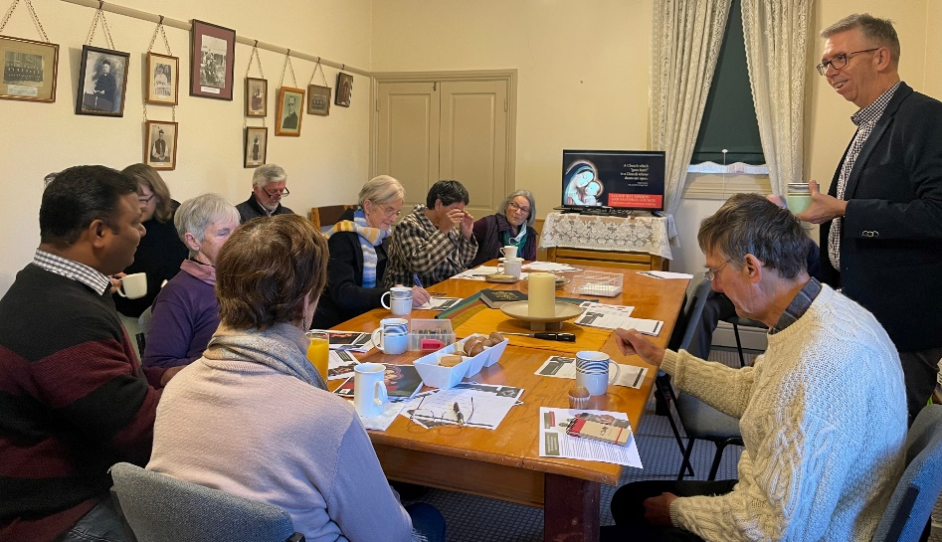
Preparation & Consultation: 6 months, 52 meetings

Slide 43
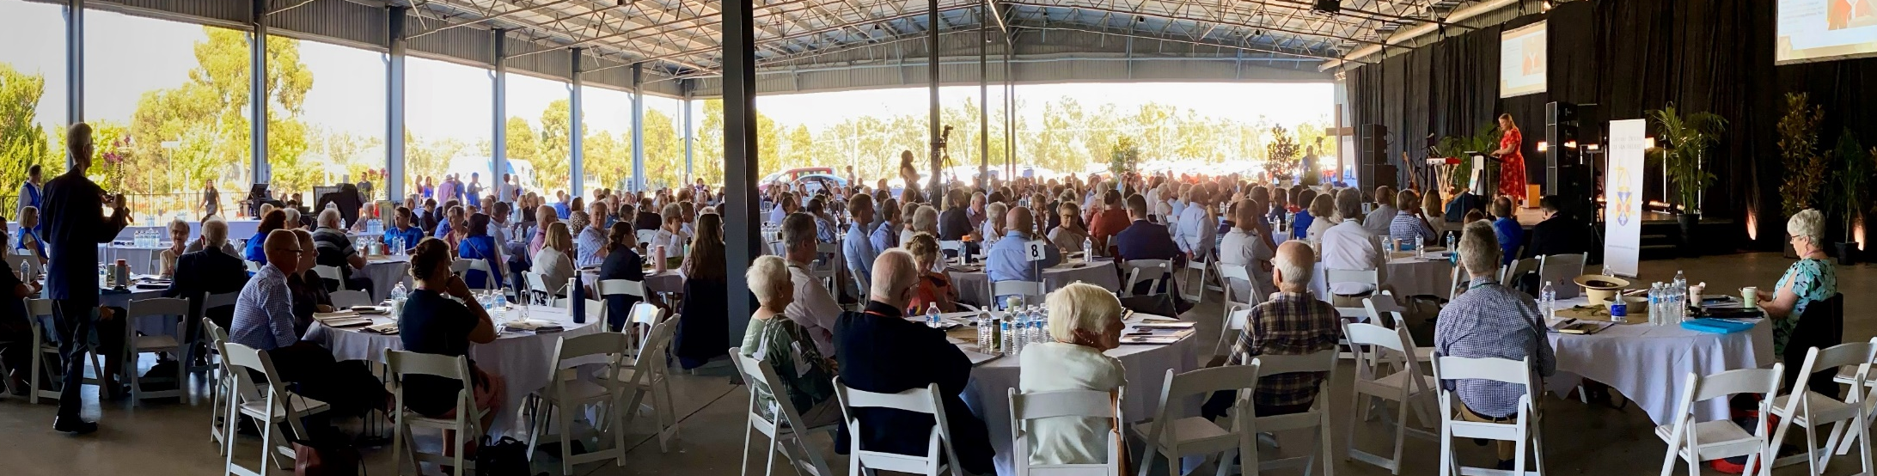
Diocesan Assembly: February 2023

Slide 44
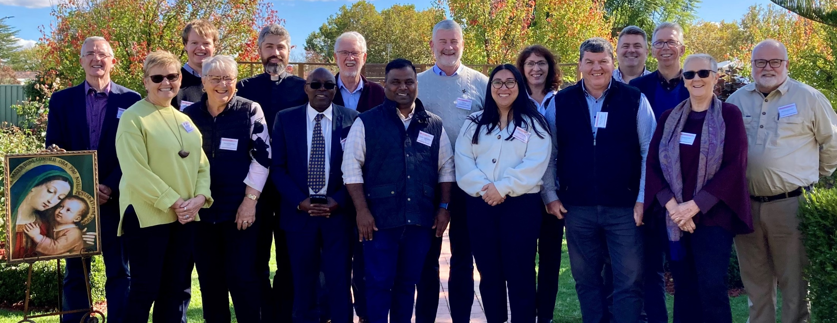
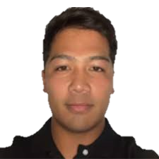
Sandhurst Mission and Pastoral Council

Slide 45
Reflection and Discussion
Identify an experience of good/synodal participation in discernment, dialogue and decision-making that you have been involved in
  What made it a good experience?
Identify an experience of poor participation in decision-making
that you have been involved in
  How could it have been a better experience?

Slide 46
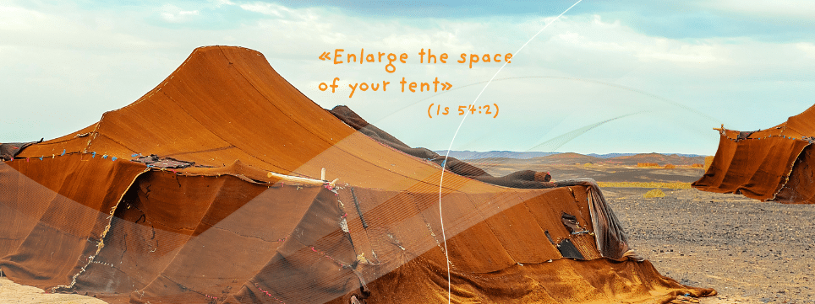
www.synod.va

Slide 47
“Enlarge the space of your tent, spread out your tent cloths unsparingly, lengthen your ropes and make firm your pegs” (Is 54:2)
‘The tent cloths … protect from the sun, wind and rain, delineating a space of life and conviviality. They need to be spread out, so that they can also protect those who are still outside this space, but who feel called to enter it.’
‘The ropes … must balance the tension needed to keep the tent from drooping with the softness that cushions movement caused by the wind. That is why if the tent expands, the ropes must be stretched to maintain the right tension.’
‘The pegs … anchor the structure to the ground and ensure its solidity, but remain capable of moving when the tent must be pitched elsewhere.’
‘Imagine the Church … as the tent of meeting, which accompanied the people on their journey through the desert: called to stretch out, therefore, but also to move. At its centre, stands the tabernacle, that is, the presence of the Lord. The tent’s hold is ensured by the sturdiness of its pegs, that is, the fundamentals of faith that do not change but can be moved and planted in ever new ground, so that the tent can accompany the people as they walk through history. Finally, in order not to sag, the structure of the tent must keep in balance the different forces and tensions to which it is subjected: a metaphor that expresses the need for discernment.’
Enlarge the Space of your Tent (2022), nn. 26–27

Slide 48
www.synod.va

